Slide 1


VISVESVARAYA TECHNOLOGICAL UNIVERSITY , BELGAVI
Computer graphics mini project presentation
on
“2D CHROME DINO”
Presented by
MOHAMMAD THANISH ALI 4BP18CS042
MUSHFIQ K 4BP18CS046
SHAHEER 4BP18CS056
Under the guidance of:
Project Coordinator:
PROF. AFSAR BAIG M
HOD CSE,
Dept. of CSE
Bearys institute of Technology
Mangalore-574153
PROF. AFSAR BAIG M
HOD CSE,
Dept. of CSE
Bearys institute of Technology
Mangalore-574153

Slide 2
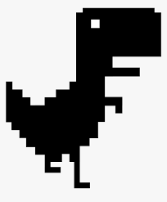
2D CHROME DINO USING COMPUTER
GRAPHICS

Slide 3
CONTENTS
Introduction
Problem statement
Methodology
Design
Implementation
Applications
Results
Screenshots
Conclusion

Slide 4
INTRODUCTION
About Computer Graphics
Computer graphics is an art of drawing pictures on computer screens with the help of programming.
About OpenGL
OpenGL is a software interface to graphics hardware.
About 2D Chrome Dino
This mini project under Computer Graphics & Visualization Laboratory is an implementation of a kind popular Simulator game using the OpenGL Graphics Library and GLUT Toolkit.

Slide 5
PROBLEM STATEMENT
The Aim of the project is to run a Dinosaur with restricted upward and downward motion using keyboard, meanwhile Cactus will move towards Dinosaur and player have to avoid a collision between them. This demo displays the helicopter game which is designed and implemented using the C++ program language and APIs provided by OpenGL. It has been developed to undergo user modifications. The user modification can be specification and movement with several other features. It is our first insight into the vast world of interactive graphics.

Slide 6
METHODOLOGY
The objective of the project is to run a Dinosaur with restricted upward and downward motion using keyboard, meanwhile Cactus will move towards Dinosaur and player have to avoid a collision between them. A 2D Dinosaur is an object standing on pitch, if we press space key in the keyboard Dinosaur will start to move against the Cactus. If collision happens between Dinosaur and Cactus, the Dinosaur gets to its original start position To avoid collision between Dinosaur and Cactus, Player has to use Arrow-Up key on keyboard. Using Arrow-Up key Dinosaur jumps over the Cactus and avoids collision

Slide 7
DESIGN
The project “2D Chrome Dino Game” is designed in C++ language using several standard header and library functions. When we Run the program, It shows the Dino placed on the floor with cactus ahead.
The user uses keyboard keys to move the Dino. We have designed a program such a way that when a user presses space key the dino starts to move ahead with the use of arrow-up key it will jump over the cactus without colliding.
The proposed system has written many functions for example movement of frames, design of the computer.

Slide 8
IMPLEMENTATION
2D Chrome Dino
The objective of the project is to run a Dinosaur restricted upward and downward motion using keyboard , meanwhile Cactus will move towards Dinosaur and player have to avoid a collision between them. The Dinosaur will come to it’s start position if a collision occurs.
User Defined Functions used in the project
In this project various functions are used to draw the various objects such as sea, house, grass, clouds, boat etc.
OpenGL In-built Function used in the project
In this project various In-built functions are used such as colour, outline, projection matrix, model view, translate etc.
Standard Header and Library Functions
standard header and library functions are used such as GL/glut, Windows, math etc.

Slide 9
APPLICATIONS
Display of information.
Design.
2D Simulation and animation.
User interfaces.

Slide 10
RESULTS
An attempt has been made to develop an OpenGL package which meets necessary requirements of the user successfully.
The proposed system will serve its purpose without any hassles.
Graphics package satisfies all requirements and provides good entertainment.
The project helped in understanding the working of computer graphics using OpenGL and various concepts, functions and methodologies for the development of a graphics packages.

Slide 11
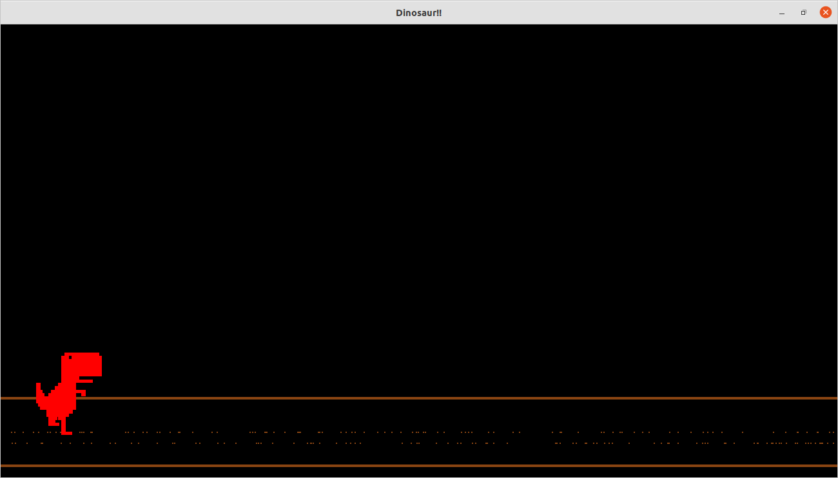
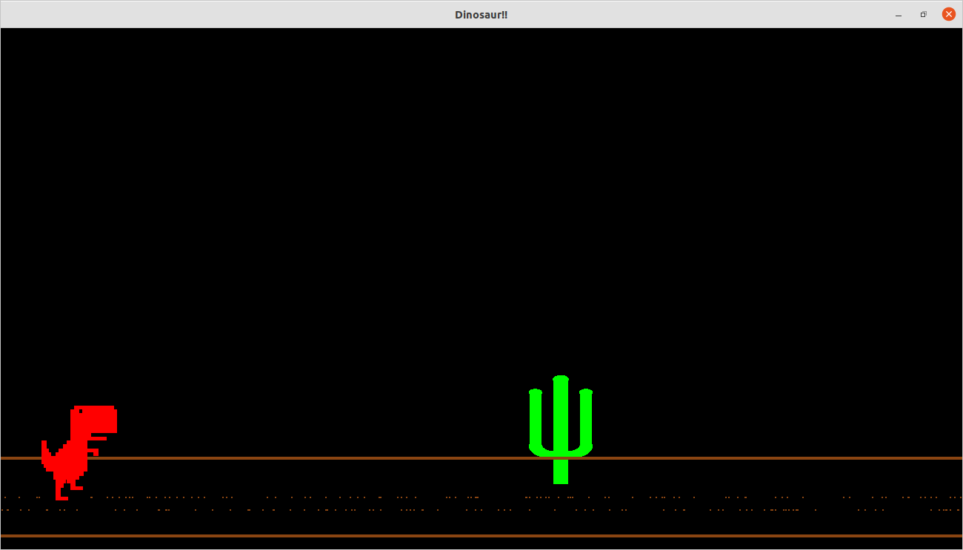
SCREENSHOTS
1. Starting screen 2. Dino Running

Slide 12
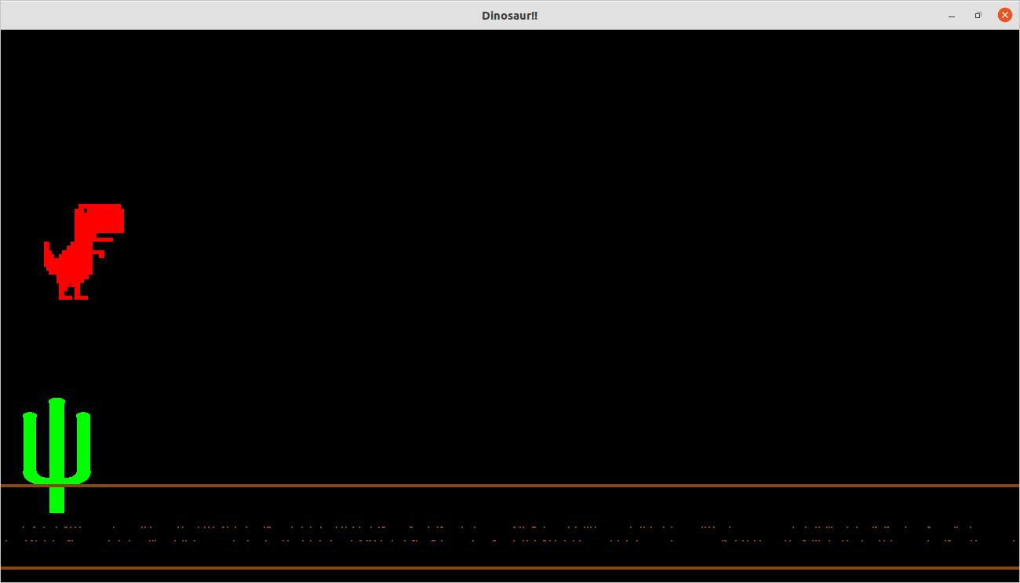
SCREENSHOTS
3. Dino jumping from cactus

Slide 13
CONCLUSION
We have attempted to design and implement “2D Dinosaur”. OpenGl supports enormous flexibility in the design and the use of OpenGl graphics programs. The presence of many built in classes methods take care of much functionality and reduce the job of coding as well as makes the implementation simpler. The project was started with the designing phase in which we figured the requirements needed, the layout design, then comes the detail designing of each function after which, was the testing and debugging stage. We have tried to implement the project making it as user-friendly and error free as possible. We regret any errors that may have inadvertently crept in.

Slide 14
THANK YOU

